Slide 1
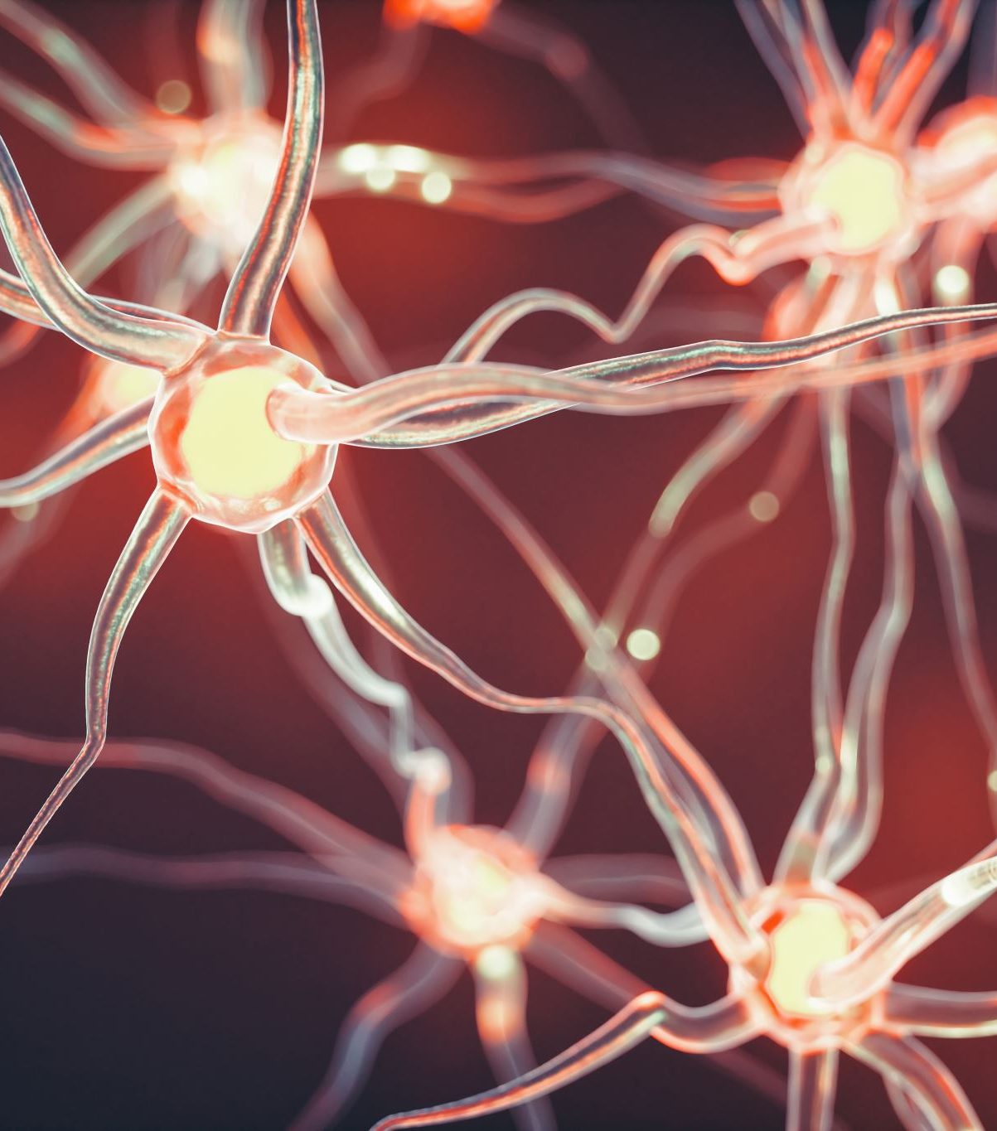
Hippocampal role in the interaction of semantic memory with learning and decision
Florian Leprévost
Prof. Dr. Bianca Wittmann
Justus-Liebig-Universität Gießen –
BION meeting 2022

Slide 2
1.1 Associative Inference
1. Introduction
A
B
A
C
B
C
Notes:
What is AI

Slide 3
1.1 Associative Inference
1. Introduction
State representation
OFC (Spalding 18, Jones 12)
OFC-hippocampus (Bowman)
Value computation
Striatum & VTA dopamine (RL)
Generalisation
OFC hippocampus (Schlichting 16)
Striatum- hippo FC (Wimmer 12)
Dopamine to MTL? (Kahnt 16)
Semantic association (Ryan et al., 2016)
Facilitates associative learning
But not if hippocampus lesion
HPC
(associated) state computation
associated value computation
OFC
St
generalisation?
reinforcement learning
VTA
Notes:
what processes/areas involved

Slide 4

How does semantic memory facilitate associative learning?

Slide 5
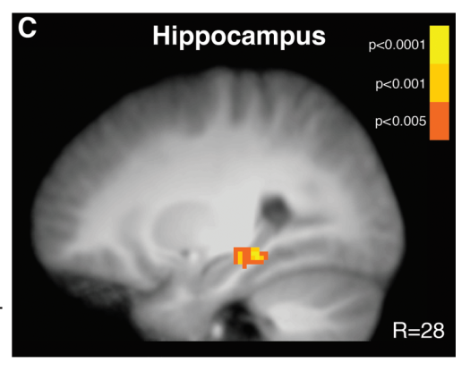
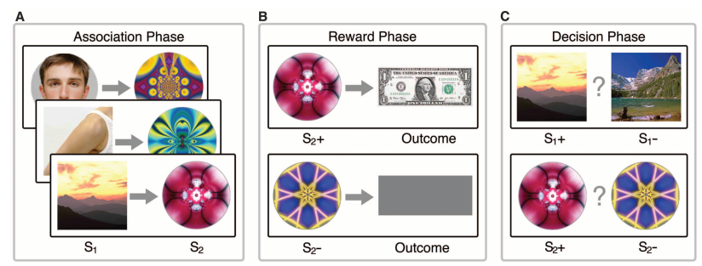
1.2 Paradigm
1. Introduction
Hippocampus activation during learning (A-B) predicts associative performance (in probe phase)
Wimmer & Shohamy 2012
Pre-conditioning Conditioning Probe
Less hippocampal involvement necessary for semantically linked pairs
Notes:
Example of xp based on this

Slide 6
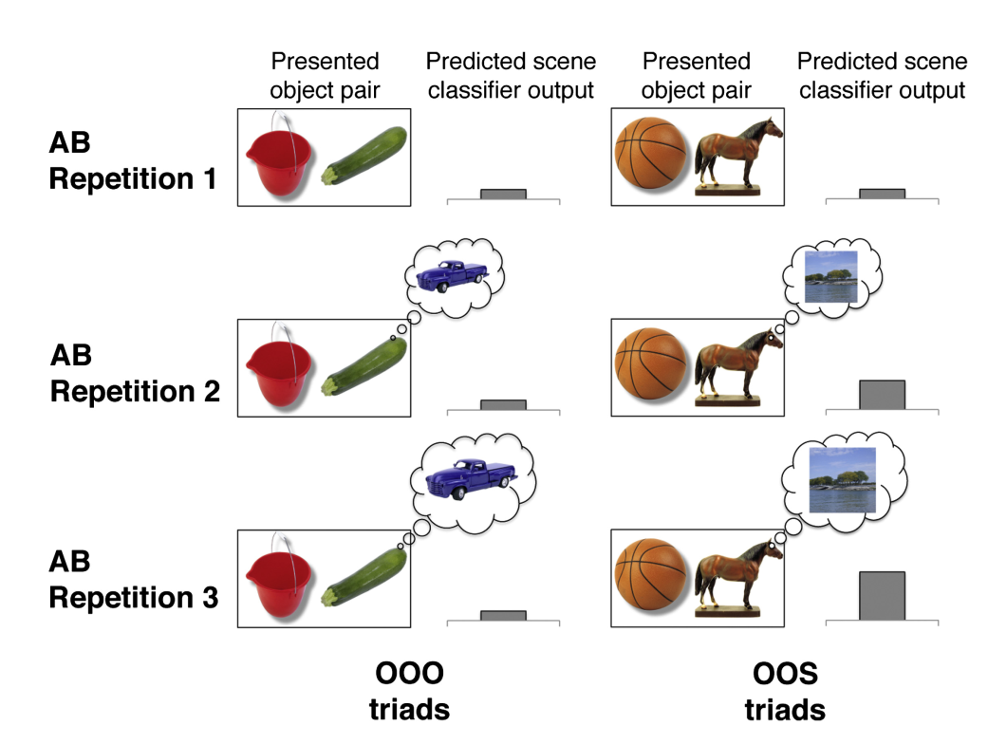
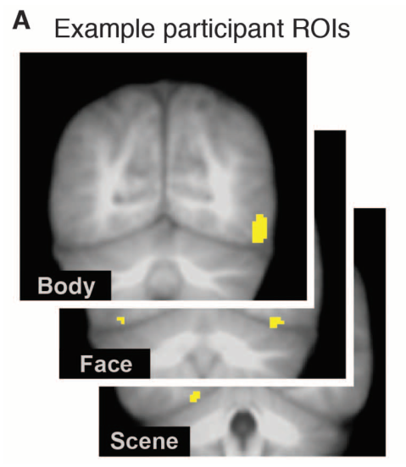
1.2 Paradigm
1. Introduction
Category specific visual areas
Train category classifier
Earlier greater classifier output for semantically linked objects

Slide 7
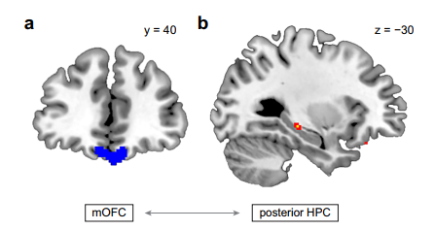
1.2 Paradigm
1. Introduction
OFC-hippo FC correls with reaction times during Probe phase (Wang)
Striatum- hippo FC during Conditioning phase correls with performance in Probe Phase (Wimmer)
Less hippocampal-OFC (and hippo-striatum) functional connectivity necessary for semantically linked pair

Slide 8
1. Introduction
1.3 Hypotheses
Hippocampal activity and connectivity reduced and unrelated to performance for semantically linked pairs
Reactivation of the associated stim in ealier repetition for the semantically linked pairs
+ candidates for semantic facilitation = IFG, entorhinal cortex, PCC

Slide 9

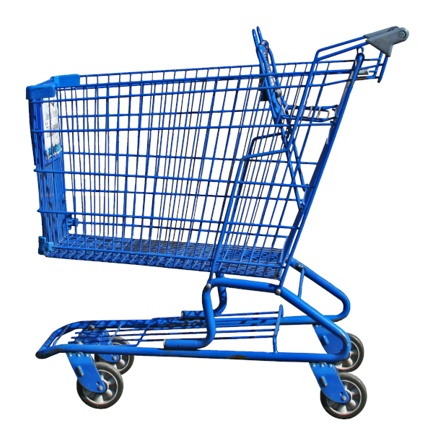

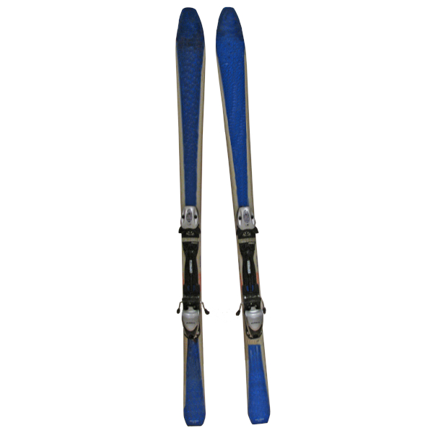

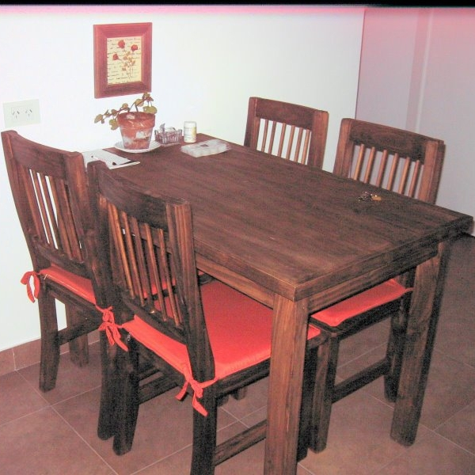


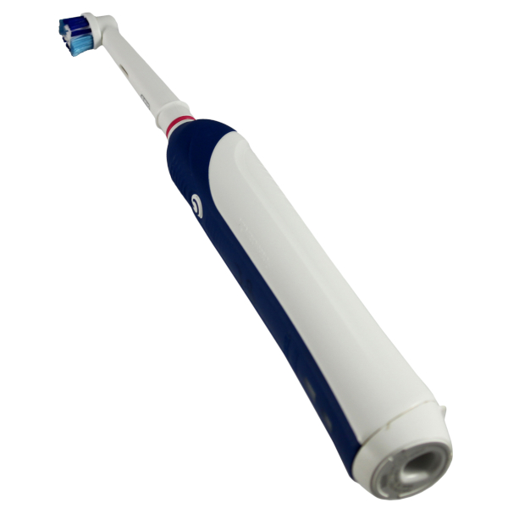

2.1 Design
2. Experiment
Semantic link
0 1
2 x 2
Semantic link
Reward
4 pairs of each = 16
Balanced
0
Reward
1

Slide 10
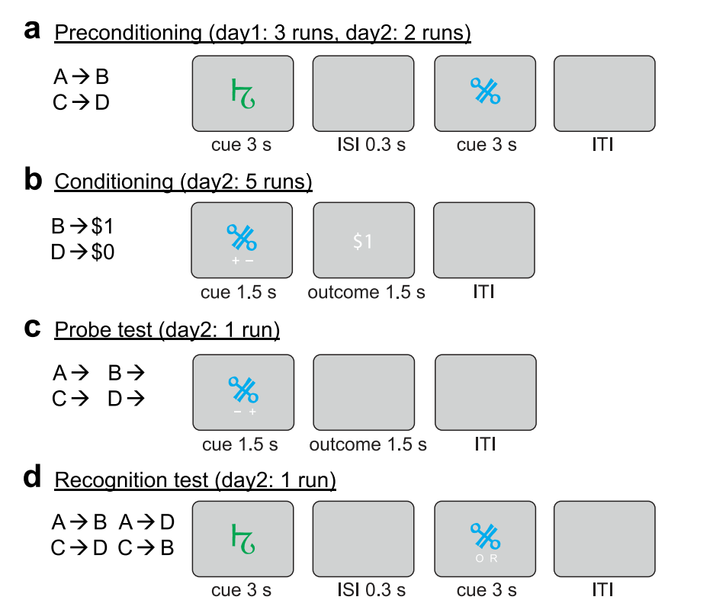
2.1 Design
2. Experiment
Pre-conditioning
Conditioning
Probe
Localizer
Distractor (avoid recency effects)
Memory
+ -
+ -

Slide 11

2. Experiment
2.2 Time course
Localizer
N-1 task on other stimuli
Preconditioning
16 S-O pairs, 6 repetitions
Conditioning
16 O-R pairs, 6 repetitions
Distractor task
N-1 task on other stimuli
Probe
32 single images, 2 repetitions
Memory
32 S-O pairs, ½ new, ½ old
~ 6 min
0,3s ITI + 2s stim
~ 7 min
S 1,5s + ISI 1s + O 1,5s + ITI 2,5s
~ 7 min
O 1,5s + ISI 1s + R 1,5s + ITI 2s
~ 6 min
#
~ 6 min
S1 1,5s + ISI 1s + O 1,5s + ITI 2s
~ 4 min
SO 2,5s + ITI 2s

Slide 12
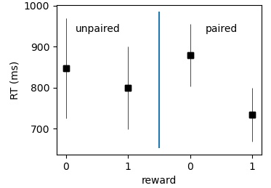
2. Experiment
2.3 Preliminary behavioral results
Semantic facilitation
n=4
Probe phase

Slide 13
3. fMRI
2.1 Sequence
nb of slices = 50
Slice thickness = 3mm
TE = 30ms
TR = 2,8s
voxel size = 3x3x3mm
iPAT grappa 2 factor

Slide 14
3. fMRI
2.2 Analyses
Regressors:
Phase
Stim onset
Contrast ANOVA 2x2
Classifiers – univariate & MVPA

Slide 15
3. fMRI
2.2 Analyses
For semantically linked pairs, is expected:
Earlier object decoding in scenes in preconditionning phase
Less link between:
hippocampal activity (and hippocampal-OFC connectivity) in first phases
& performance in last phase
To determine
Predictor of perf? RSA?
searchlight? ROIs?
Seed connectivity with striatum?
Earlier reactivation
Hippocampus only necessary for new association
Semantic processes

